Slide 1
Cloud Research
By Arabella, Hannah, Madalina

Slide 2
Contents/Agenda
What is Cloud?
Types of Cloud Computing
Cloud Platforms - AWS, Microsoft Azure, Google Cloud and their key differences
How cloud is used by Data Engineers

Slide 3
What is the Cloud?
Servers and services accessed over the internet.
It is where files and large amounts of data are stored online. Examples - Microsoft One Drive.
There are lots of different types of storage models clouds such as personal, private, commercial, and hybrid.
There are also different types of cloud computing models which I will speak about on the next slide.

Slide 4

Types of Cloud Computing
Three main ones:
SaaS (Software as a service) - A software service over the internet. Accessed directly through the web browser.
Examples - Gmail, Zoom, Netflix, Microsoft Office 365.
PaaS (Platform as a service) - An internet service used as a platform.
Examples - Heroku, Salesforce.
IaaS (Infrastructure as a service) - Infrastructure service across the internet. Doesn’t require physical hardware.
Examples - AWS EC2, Microsoft Azure services,
Less well known are:
FaaS (Function as a service) - Function services across the web that are can manage applications without infrastructure or servers.
Examples - Google Cloud Functions
CaaS(Containers as a service) - Containers as a service. Deploys and hosts containers and applications through an API.
Examples - Docker.

Slide 5
3 Major Cloud Computing Platforms

Slide 6
AWS
(Amazon Web Services)

Slide 7

What is AWS
Amazon Web Services (AWS) is the world’s leading cloud computing platform, offering on-demand IT resources all over the internet
On-Demand Services
Global Infrastructure
Scalability
200+ Services

Slide 8
AWS: Pros and Cons
Pros
Comprehensive service portfolio
Global infrastructure
Scalability and Flexibility
Security
Innovation pace
Large community
Cons
Pricing complexity
Vendor Lock in
Learning Curve
Shared security responsibility

Slide 9
Real Life Uses
Epic Games
Fortnite - Built on AWS
EC2 (Elastic Compute Cloud) - On demand Scalable Computing capacity (virtual servers)
S3 (Simple Storage Service) - Scalable storage service, that is durable with high availability and performance
Why?
By utilizing these technologies especially the scalability Epic can make sure that Fortnite is always available to the players

Slide 10
Microsoft Azure

Slide 11
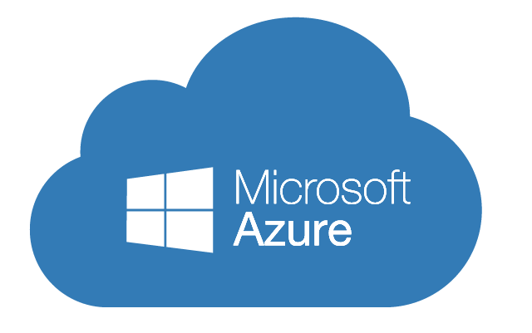
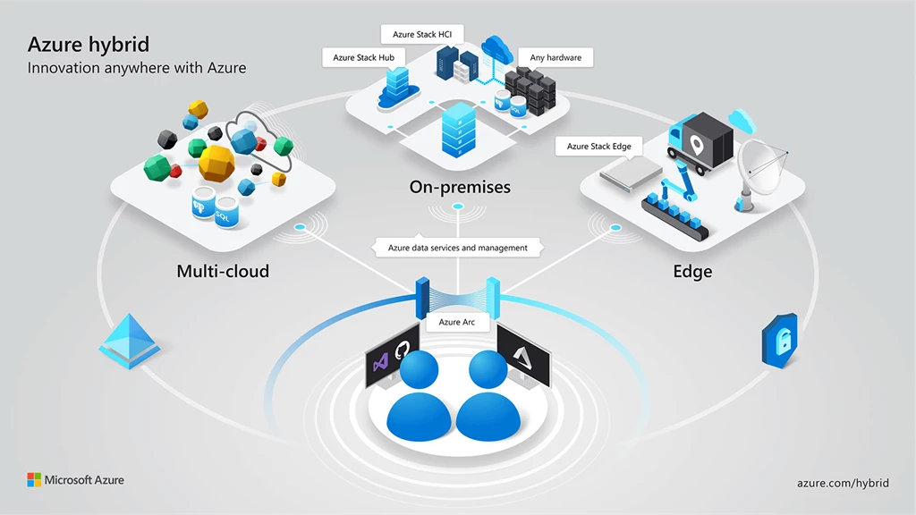
Microsoft Azure
Cloud computing platform and service created by Microsoft, providing a wide range of cloud services including computing, analytics, storage, networking & AI.
Launched in 2010
Second largest cloud platform globally
Seamless Microsoft Integration (Windows Server, Office 365 etc.)
Known for Hybrid cloud, enterprise tools
Key services: Azure VMs, Azure SQL, Azure AD, Cognitive Services

Slide 12
Microsoft Azure: Pros & Cons
Pros
Seamless Integration with Microsoft Products
Strong Enterprise and Hybrid Cloud Support
Global Reach and Scalability
Cons
Complex Pricing Structure
Steep Learning Curve
Interface & Usability Challenges

Slide 13




Microsoft Azure: Real Life Cases
HSBC - uses Azure to build secure, scalable banking applications.
GE Healthcare - uses Azure to build cloud-based medical imaging solutions.
Marks & Spencer - uses Azure for portions of its e-commerce platform and data infrastructure.
Heathrow Airport - uses Azure for IoT, analytics and operational management.

Slide 14
Google Cloud

Slide 15
What is GCP
GCP (google cloud platform) is Google's cloud platform and like the others it proves users with access to:
Computing and hosting
Storage and Databases
Machine Learning
Data Analytics
More

Slide 16
GCP Pros and Cons
Pros
Range of services
Scalability
Only pay for services you use
Best For AI/Ml
Great Network Performance
Cons
Complex pricing
Less Services than the others
Limited availability of data centres

Slide 17

Real Life Uses
Victoria secret are using GCP’s Gen AI to implement a Visual Search technology that allows customers to photograph and Bra whether bought from victoria's secret or not and instantly find similar products, this use of GCP improves the customer satisfaction and helps reduce mundane work for the associates

Slide 18
Key Differences of using AWS, Microsoft Azure & Google Cloud

Slide 19
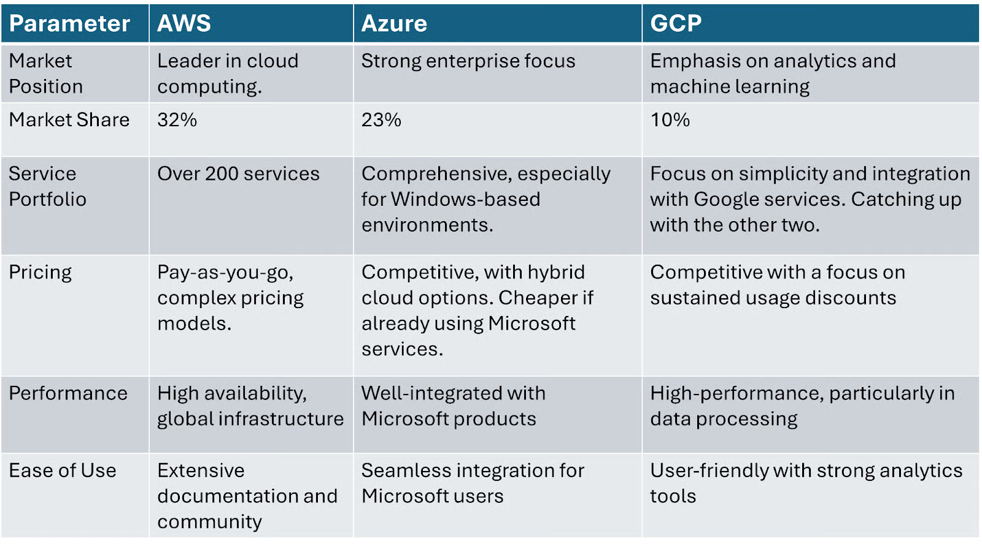
Key Differences

Slide 20
How Is the Cloud Used by Data Engineers?

Slide 21
Cloud Usage by Data Engineers
Machine Learning & Analytics
Cloud platforms offer AI & ML services for data engineers to create models and insights
Azure Cognitive Services
AWS Sage Makers
Google AI Platform
Data Storage at Scale
Data engineers can store huge volumes of data collected from various sources (websites, apps, IoT devices) in cloud storage solutions.
Azure Blob Storage
Amazon S3 (AWS)
Google Cloud Storage
Automation and Scalability
Cloud allows data engineers to automate workflows, schedule data pipelines, and scale resources dynamically.
Data Processing & Transformation
Cloud compute services can be used to clean, transform and prepare raw data into usable formats.
Azure Databricks
AWS EMR
Google Dataproc
Data Warehousing
Used to build and maintain data warehouses in the cloud to enable easy querying and analytics.
Azure Synapse Analytics
Amazon Redshift
Google BigQuery

Slide 22
Thank you for listening to our presentation!

